Slide 1
Web3, Session 2
TypeScript (II)

Slide 2
Questions about the assignment?

Slide 3
Beyond simple TypeScript
We want precise types:
Guarantee against (certain types of) errors
Allows everything you reasonably want to do
That makes type systems complex
TypeScript is one of the more complex
They still need ‘any’ as an escape clause
On top of that, we want to follow the DRY principle
Only write the same piece of logic once
Only one place to change things

Slide 4
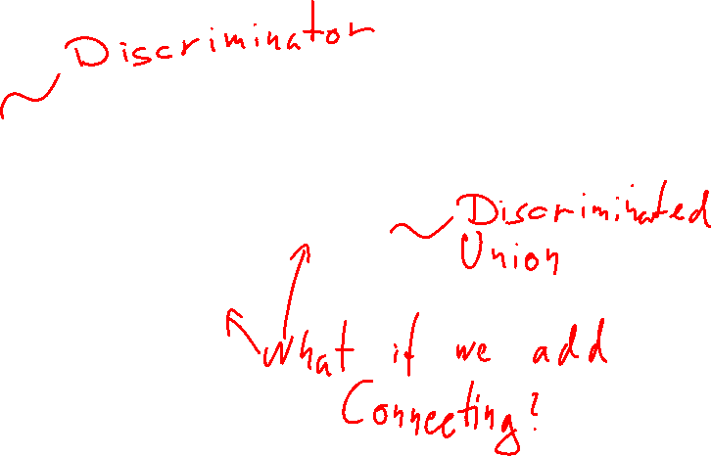
Keeping it DRY
From last time: type LoadingState = {status: 'loading', percentComplete: number} type FailedState = {status: 'failed', statusCode : number} type OkState = {status: 'ok', payload: number[]} type State = LoadingState | FailedState | OkState
Bad: type Status = 'loading'| 'failed' | 'ok'
Good: type Status = State['status']

Slide 5
Covered in this session
Type predicates
Immutability
Utility Types
Type manipulations
(time permitting) Type helpers

Slide 6
Why Type Predicates?
type LoadingState = { percentComplete: number }
type FailedState = { statusCode : number }
type OkState = { payload: number[] }
type State = LoadingState | FailedState | OkState
function reportStateError(state: State) {
if ((state as LoadingState).percentComplete !== undefined) {
console.log(`Loading ${state.percentComplete}% done`)
} // And so on
}

Slide 7
Type predicates
function isLoading(state: State): state is LoadingState {
return (state as LoadingState).percentComplete !== undefined
}
function isFailed(state: State): state is FailedState {
return (state as FailedState).statusCode !== undefined
}
function isOk(state: State): state is OkState {
return (state as OkState).payload !== undefined
}

Slide 8
Using type predicates
function reportState(state: State) {
if (isLoading(state)) {
console.log(`Loading ${state.percentComplete}% done`)
} // And so on
}

Slide 9
Immutability
It's important to manage state change
Better correctness
Easier asynchronous programming
Immutability means: You cannot change this
Easier to reason about the code
Example: Playing cards type PlayingCard = { readonly suit: Suit, readonly rank: Rank }

Slide 10

What's going on here?
const statusCodes = {
ok: 200,
"Not found": 404,
"Internal Server Error": 500
}
statusCodes.ok = 201 // Not an error

Slide 11
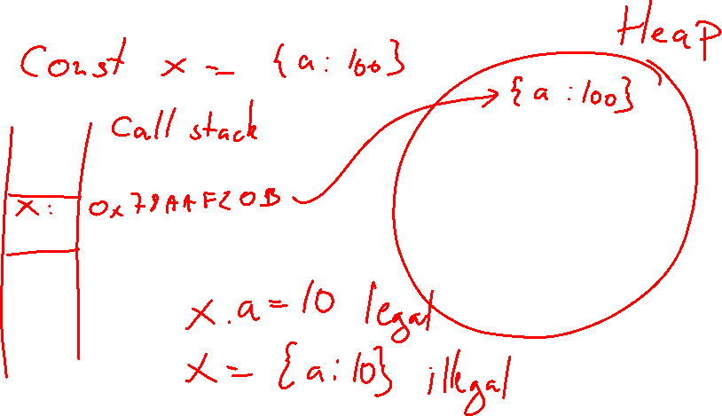
const and references

Slide 12

as const
const constStatusCodes = {
ok: 200,
"Not found": 404,
"Internal Server Error": 500
} as const
type ImmutableStatusCodes = typeof constStatusCodes

Slide 13

const array
const Suits = ['Clubs', 'Diamonds', 'Hearts', 'Spades'] as const
type SuitsType = typeof Suits
type ClubType = SuitsType[0]
type Suit = SuitsType[number]

Slide 14
Readonly
type StatusCodeType = {
ok: number,
"Not found": number,
"Internal Server Error": number
}
type ImmutableStatusCodeType2 = Readonly<StatusCodeType>

Slide 15
Utility types
Utility types are standard type manipulations implemented by TypeScript
Readonly<{ a: number }> == { readonly a: number }
They look just like generics, but they aren't
They are a form of type helpers
Think of them as functions that takes types and return new types

Slide 16
Partial
const e2: Partial<Employee> = {
name: 'Donald Duck',
age: 33
}
type Employee = {
name: string,
age: number,
salary: number
}
const e1: Employee = {
name: 'Donald Duck',
age: 33
}

Slide 17
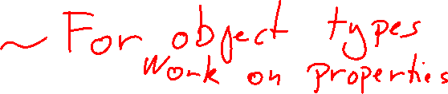
Pick and Omit
const e3: Pick<Employee, "name" | "age"> = {
name: 'Donald Duck',
age: 33
}
const e4: Omit<Employee, "salary"> = {
name: 'Donald Duck',
age: 33
}

Slide 18

Extract and Exclude
type LoadingState = { status: 'loading', percentComplete: number }
type FailedState = { status: 'failed', statusCode : number }
type OkState = { status: 'ok', payload: number[] }
type State = LoadingState | FailedState | OkState
type FinishedState = Extract<State, {status: 'failed' | 'ok'}>
type FinishedState2 = Exclude<State, {status: 'loading'}>

Slide 19
Combining utility types
const statusCodes: Readonly<Record<string, number>> = {
"ok": 200,
"Not found": 404,
"Internal Server Error": 500
}

Slide 20
Type manipulations
Creating types from other types
keyof creates a union of the property keys of an object type
keyof {n:number, s: string} === 'n' | 's'
Index signatures creates an object type from other types
Exactly like a Record
String type manipulations for unions of string types
Template literal types

Slide 21
keyof
const constStatusCodes = {
ok: 200,
"Not found": 404,
"Internal Server Error": 500
} as const
type StatusCodes = typeof constStatusCodes
type StatusCodeKeys = keyof StatusCodes

Slide 22
Using keyof with generics
function objectKeys<T extends {}> (obj: T): Array<keyof T> {
return Object.keys(obj) as Array<keyof T>
}
function getter<T extends {}, K extends keyof T>
(obj: T, k: K): () => T[K] {
return () => obj[k]
}

Slide 23
Index signatures
type Keys = 'ok' | 'Not Found' | 'Internal Server Error'
type StatusCodes = {
readonly [key in Keys]: number
}
type StatusCodesHandler = {
readonly [key in keyof StatusCodes]: (code: StatusCodes[key]) => void
}

Slide 24
Type Helpers
Type helpers look like generic types, but they are not
They are a kind of type function: They take types and returns new types
Like generic types you can put type constraints ("extends")
This is how the utility types are made

Slide 25
Type Helper Example
type Species = 'Dog' | 'Cat'
type Dog = 'Boxer' | 'Husky' | 'German Shepard'
type Cat = 'Siamese' | 'Persian' | 'Manx'
type Annotated<S extends Species, R extends string> = `${S}: ${R}`
type Animal = Annotated<'Dog', Dog> | Annotated<'Cat', Cat>

Slide 26
Conditionals in type helpers
Since type helpers are functions, we might need conditionals
Conditionals have the form SomeType extends OtherType? TrueType : FalseType
The types in the expression can be any type expression
Example: type PrimitiveArray<T> = T extends number | string | boolean ? T[] : never
If the type is a primitive make an array, otherwise don't bother

Slide 27
Type helper with conditionals
type PrimitiveArray<T> =
T extends number | string | boolean ? T[] : never
type A = PrimitiveArray<string | number | Object>
type B = PrimitiveArray<boolean>

Slide 28
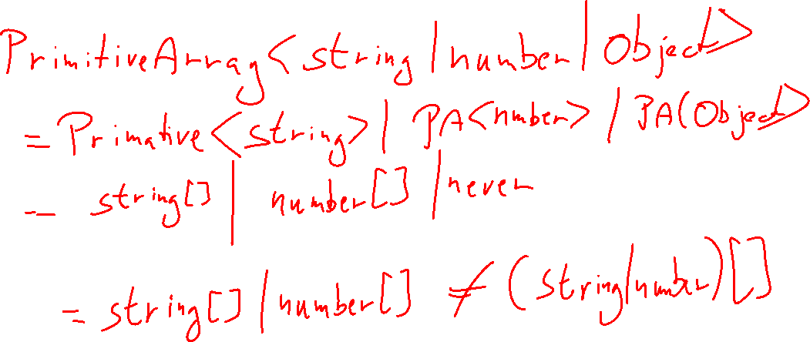
Distributive conditionals

Slide 29
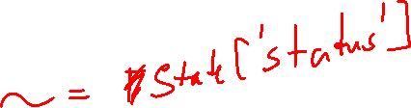
Type inference in conditionals
type FieldType<T, K extends string | symbol | number> =
T extends { [key in K]: infer U }? U : never
type LoadingState = { status: 'loading', percentComplete: number }
type FailedState = { status: 'failed', statusCode : number }
type OkState = { status: 'ok', payload: number[] }
type State = LoadingState | FailedState | OkState
type X = FieldType<State, 'status'>
type Y = FieldType<State, 'statusCode'>

